Slide 1
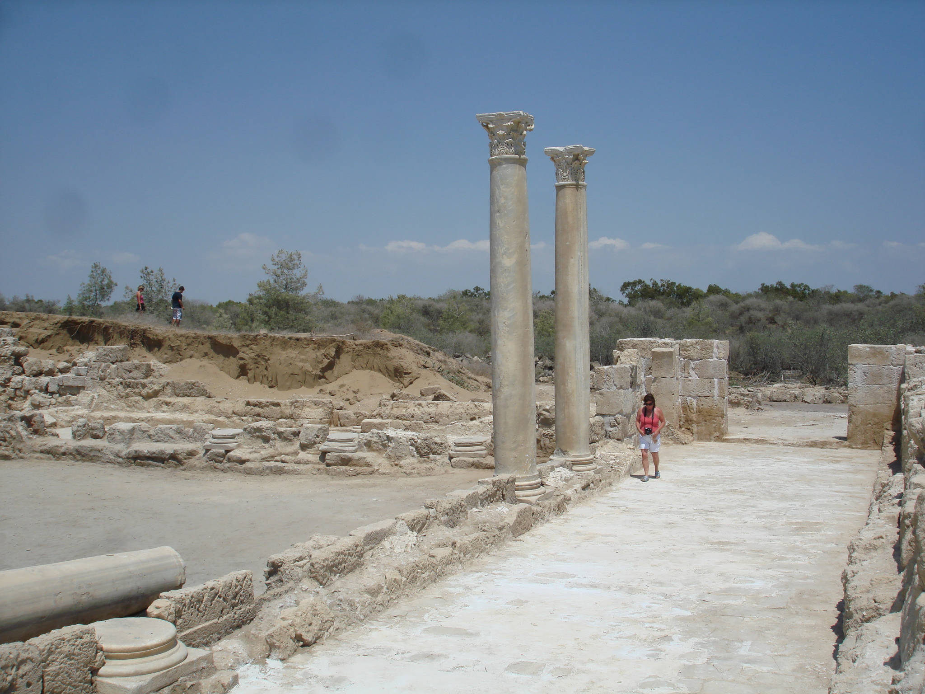
The Jewish Diaspora in Cyprus: here, but not here
Tom Davis, Ph.D.
Tandy Institute for Archaeology
SWBTS

Slide 2
You can not always choose who you work with…

Slide 3
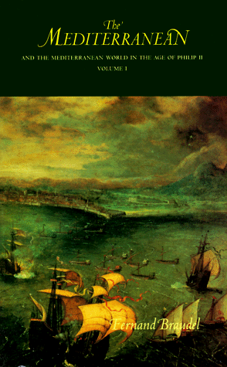
“Permanent values” - Braudel
Cyprus Spatial values:
Island identity
Strategic location
Natural resources
Temporal Values:
Language
Religion

Slide 4
Island Identity

Slide 5
Spatial Value: Strategic Location
Especially when Eastern Mediterranean is battle zone

Slide 6
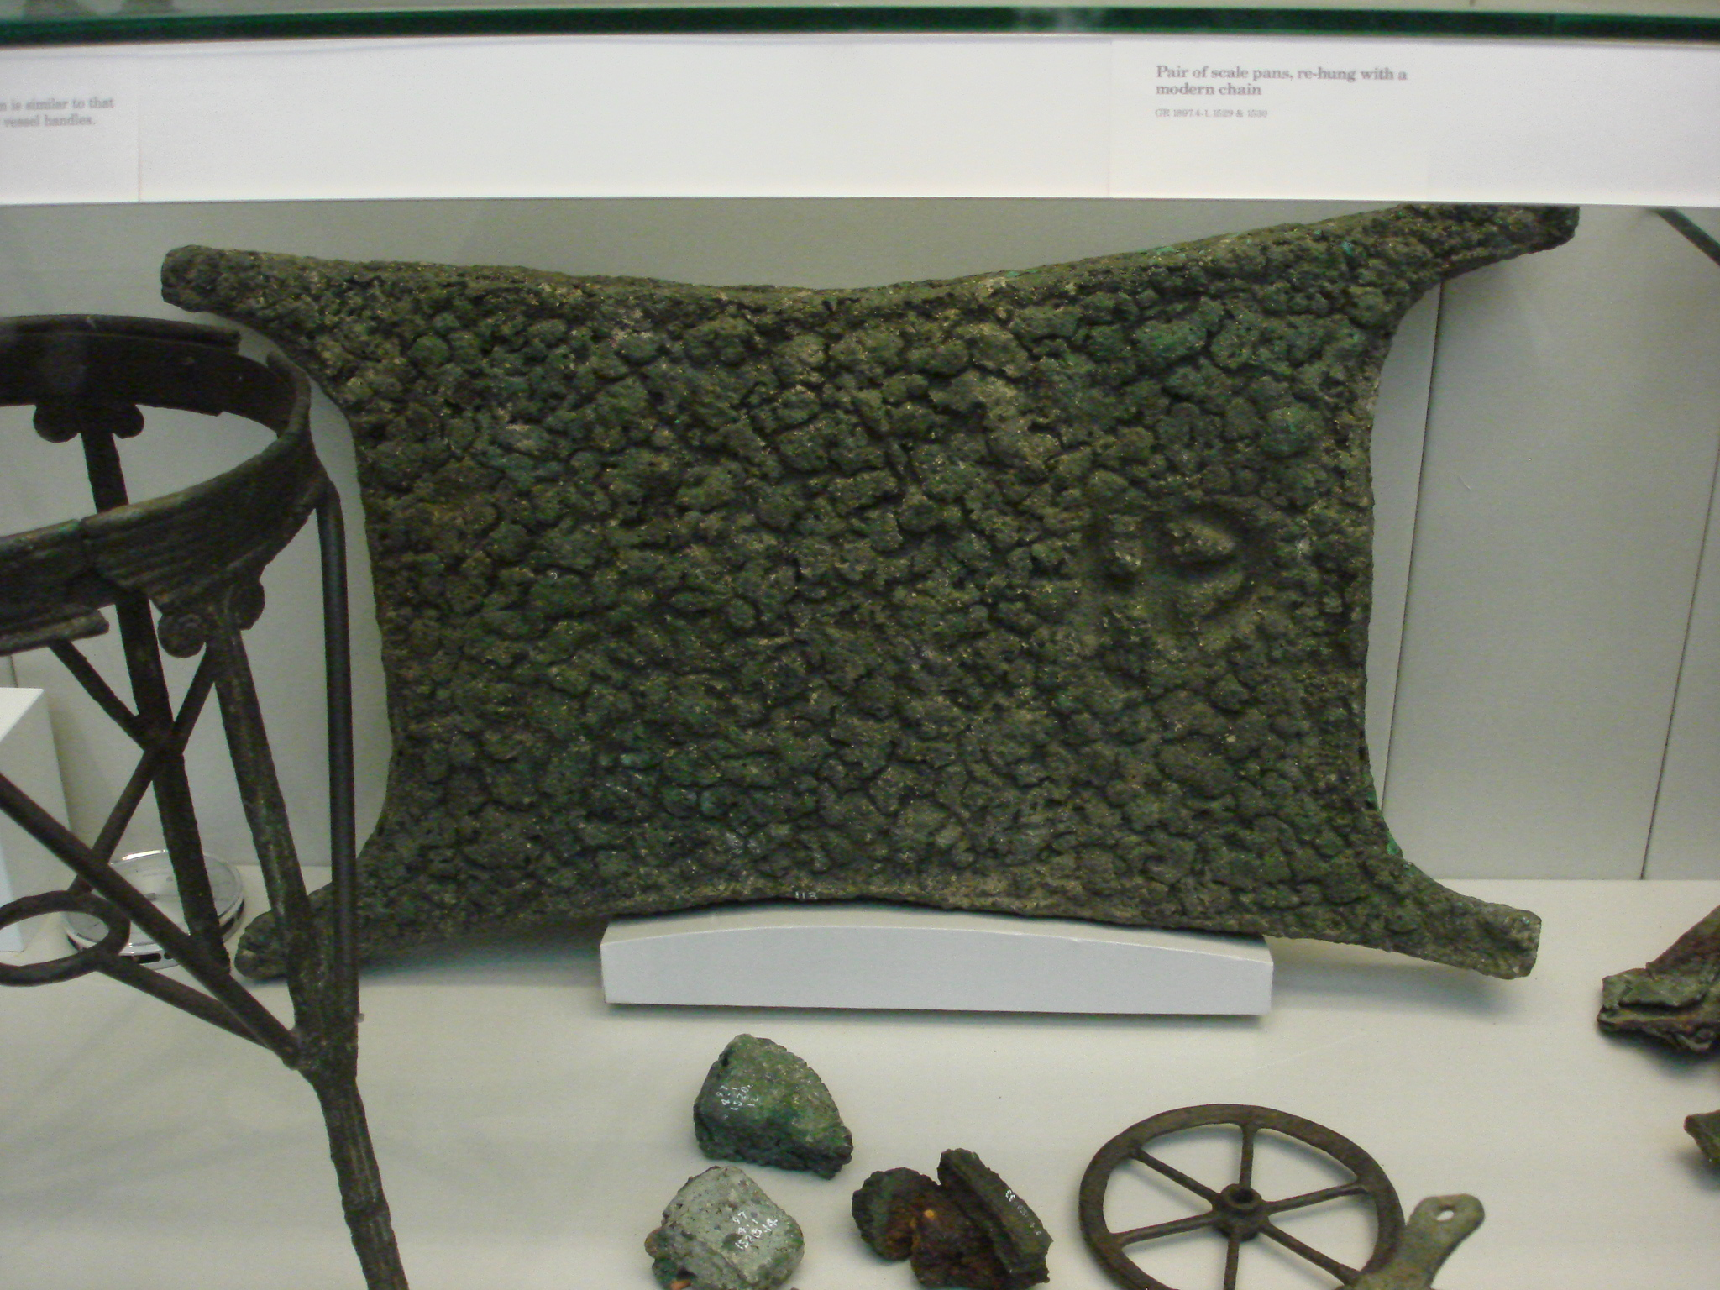
Spatial Value: Strategic Resources

Slide 7
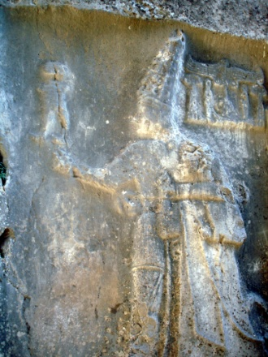
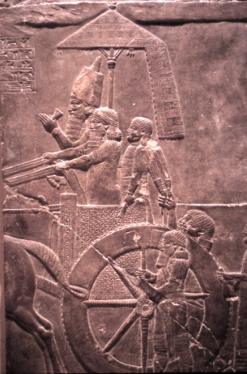
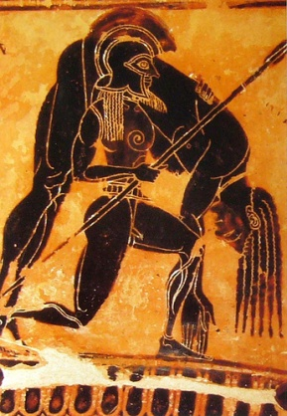
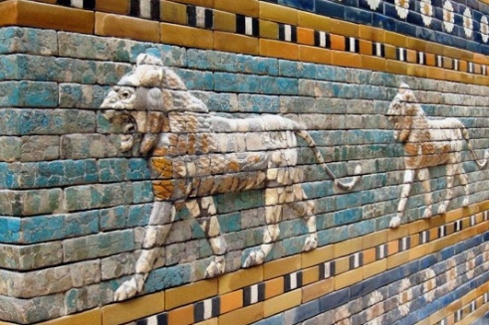
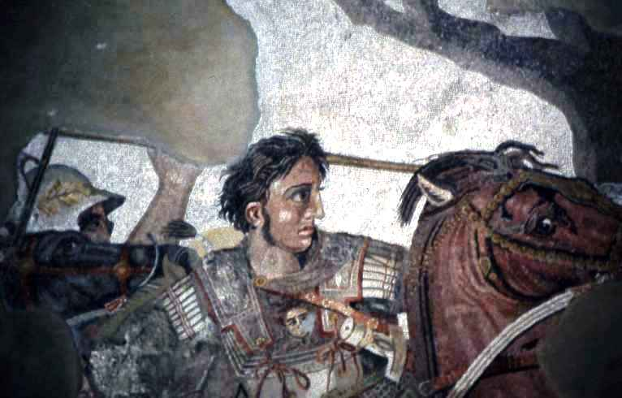
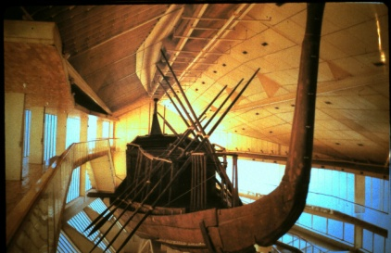

Slide 8
Kittim
Cypriots are “other” to the Hebrews of the Iron Age
Kittim mercenaries in Arad ostraca.
Regular trade relations
Contact filtered through Phoenicians.
Syro-palestinian pottery found in Cyprus but no clear evidence of direct presence.
Cypriot limestone cult statues in Persian period favissae in Phoenician Palestine (Tel Dor)
If Hebrews came, they are not discernable.
Biblical witness is that the Phoenicians were the middlemen for the maritime trade of the kingdoms
Traditional Research agenda is to emphasize Aegean contacts, not eastern ones.
Kition (Larnaca) Phoenician temple

Slide 9
Cypriot direct contact
Evagaros I of Salamis rules pagan north coast of Palestine from 400-380 including Tel Dor
Ally of Egyptian native dynast and Athens
Expelled by armies of Artaxerxes II after treaty with Athens
Only a handful of coins from Cyprus in Palestine
Palestinian Jewry was loyal to Persia

Slide 10
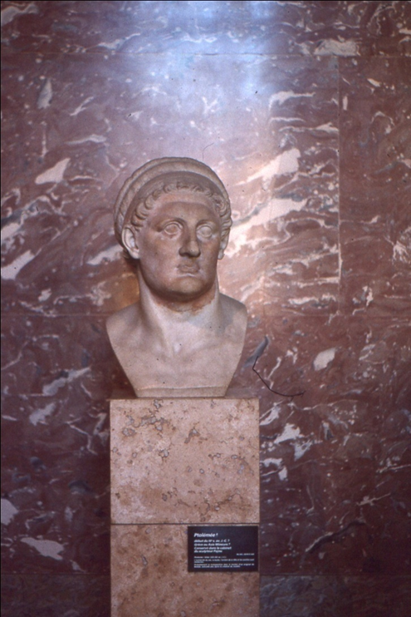
The world changes
Alexander brings Cyprus into his control to remove the Persian fleets
After his death, According to Aelian (Varia Historia 12.64), Ptolemy Lagus who becomes Ptolemy I Soter intercepts the funeral procession on the way to Macedonia, and brings Alexander’s body to Alexandria.
Augustus sees the body and knocks off the nose!
Ptolemy bows out of “the Funeral games” by not seeking overall kingship and sets up a separate state in Egypt

Slide 11
Ptolemaic beginnings of settlement
Jewish settlement on Cyprus begins with Ptolemy’s conquest in 294.
Philo records”many” Jewish communities
Nea Paphos founded as new center of Egyptian rule because it is a direct sail to Alexandria

Slide 12
Economic engine
Closed economic system
Foreign traders must convert coinage
Chief minister the dioketes the financial minister
Follows Pharaohnic pattern where all land is the King’s

Slide 13
Protect the heartland
Permanent rule over Cyprus from 294 BC
Constant wars with Syria over Palestine
Control over Cyreneaica
Naval bases in Aegean and Anatolian coast
Alliances with Rhodes and others

Slide 14
Ptolemy II Philadelphus
“His ships proclaim him sovereign of the seas”

Slide 15
“Because they ruled the territories of Koile Syria and Cyprus the earlier Ptolemies had always been able to put pressure on the kings of Syria both by sea and by land…the kings of Egypt had never felt anxiety concerning their rule at home”
- Polybius
Paphos walls

Slide 16
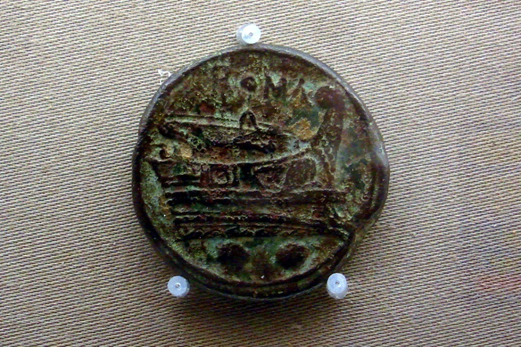
Cypriot strategic resources

Slide 17
Strong ties
Ptolemaic rule lasts 3 centuries
Rule by a strategos,
sometimes an exiled member of the ruling house
Strong economic and cultural ties
Funerary architecture
so-called “Tombs of the kings”
Alexandrian ceramics in Paphos

Slide 18
coinage
Nea Paphos house of Orpheus horde. 76 coins:
59 Ptolemaic in date
all from Cyprus except 4 from Alexandria

Slide 19
Jewish ties?
Found in secondary context in 5th CE house of Eustolios at Kourion
May refer to Onias II the Jewish high priest who founds Leontopolis temple
Power over religious and fiscal matters
Chalenges Ptolemy III
Joseph son of Tobias becomes tax farmer for Stria, Phoenicia, Judea and Samaria, but NOT Cyprus
Too important?

Slide 20
Amathus inscription:synagogue?
Late Hellenistic Fragmentary inscription Ananias is the presumed ruler of the synagogue and this deals with cedar wood for a doorway

Slide 21
Rome understands geography Cyprus controlled in 58 BC
A Major blow to
Ptolemaic Egypt
Comes under Anthony’s
Control after death of
Caesar

Slide 22
Cleo gets what Cleo wants
Cyprus is necessary for Ptolemic power
Given by Anthony to Cleopatra in 36 BCE
She understands geopolitics
Wants Judea as wedding Present!

Slide 23
Cleopatra makes an emphatic statement of control
Yeronisos Island sanctuary to Cleopatra and Caesarian
Isis and Horus
Located where ships from the west first make landfall
A message to Rome?
Augustus issues Cypriot coins that echo Julius Caesar

Slide 24
An Economic asset
Augustus makes Cyprus a senatorial province
Loses military significance because Rome now rules entire Mediterranean coast
Maintains strategic economic importance because of copper mines and other resources
Herod given some mines
Roman slag heap

Slide 25
After Actium: A backwater province of Rome
Proconsul rule : Luke gets it right
Only 1/6th of governors are known by name
Not top tier: only 6 go on to be consuls
Under the eye of Antioch
Not rich
Not militarily significant

Slide 26
Jewish presence in Cyprus under Rome
Historical accounts
Josephus
1 macc 15:23
documents diaspora spread
Acts of the Apostles
Dio Cassius
Coinage
Possible trade evidence

Slide 27
Acts of the apostles
Acts 4: Barnabas, a Jewish Christian from Salamis in Cyprus sells some land he owns in Jerusalem for the church
Acts 11: Cypriot and Cyrene Jewish-Christians found the church in Antioch
Acts 13 Paul of Tarsus, Barnabas, and John mark make a mission visit to Cyprus, visiting synagogues “throughout the whole island”
Roman roads

Slide 28
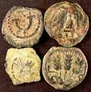
Coins show strong Jewish economic presence
First century CE: 40% of all coins found in Cyprus are from Judea
The rest are local Cypriot and provincial particularly Antioch and Cilicia; some imperial
Alleged Cypriot horde (57 coins) bought on the antiquities market
in a jar on the karpass
included only Judean and Nabatean coins (3) from Hasmonean period to 70 CE

Slide 29
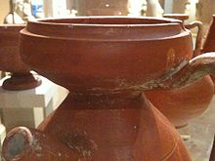
Evidence from Cypriot Sigillata
Produced in the region of Paphos
Dominant fine ware in SW Cyprus
First century BCE to second century CE
Exported off island
“part of the production was made especially for export… no information about the ethnicity of the merchants”
John Lund (1997:207)

Slide 30
Lund suggests this pattern may be a product
Of the “Ptolemaic Commonwealth”
But recognizes the lack of finds
from Alexandria is problematic

Slide 31
Second century collapse
Severe drop off after first quarter (?) of second century CE
“pronounced decrease after about 100 CE, and a dramatic one after 150”
John Lund 1997: 207)
suggests second century earthquakes on Cyprus
Lund 1997:207

Slide 32
A possible scenario
First drop off is caused by the revolt of the Jews in 66 and the subsequent destruction of their market
Impact increased by absorption of Petra and dominance of Nabatean market by Roman eastern sigillata in 106 CE

Slide 33
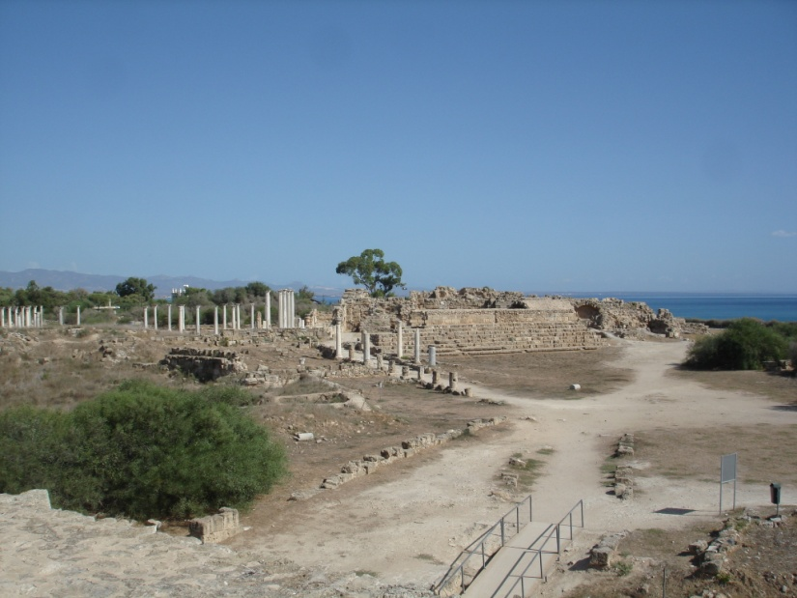
A key event: Diaspora Revolt 117 CE
Dio records it with no real cause given.
He locates it in Cyrene, Egypt and Cyprus.
240,000 die in Cyprus
“No Jew may set foot on this island”
Temples targeted in Cyrene: Isis, Zeus, Demeter
Possibly temple of Apollo at Kourion.
Alexandria
Salamis

Slide 34
Impact of the Revolt on the trade
I suggest the merchants carrying Cypriot Sigillata off the island and the potters themeslves were actually Jewish Cypriots
Explains why Judea, Galilee and Nabatea are the main overseas markets
Pagans try to continue but unable to either create the ceramics or market the replacements.

Slide 35
Why the Revolt?
Unlikely to be coincidental with attacks on Mesopotamia
Babylon largest Jewish center outside Empire (now inside!)
Long term Parthian connections
Removal of Petra and expansion of Rome seen as threat by Jews? Used as provocateurs by Parthians?

Slide 36
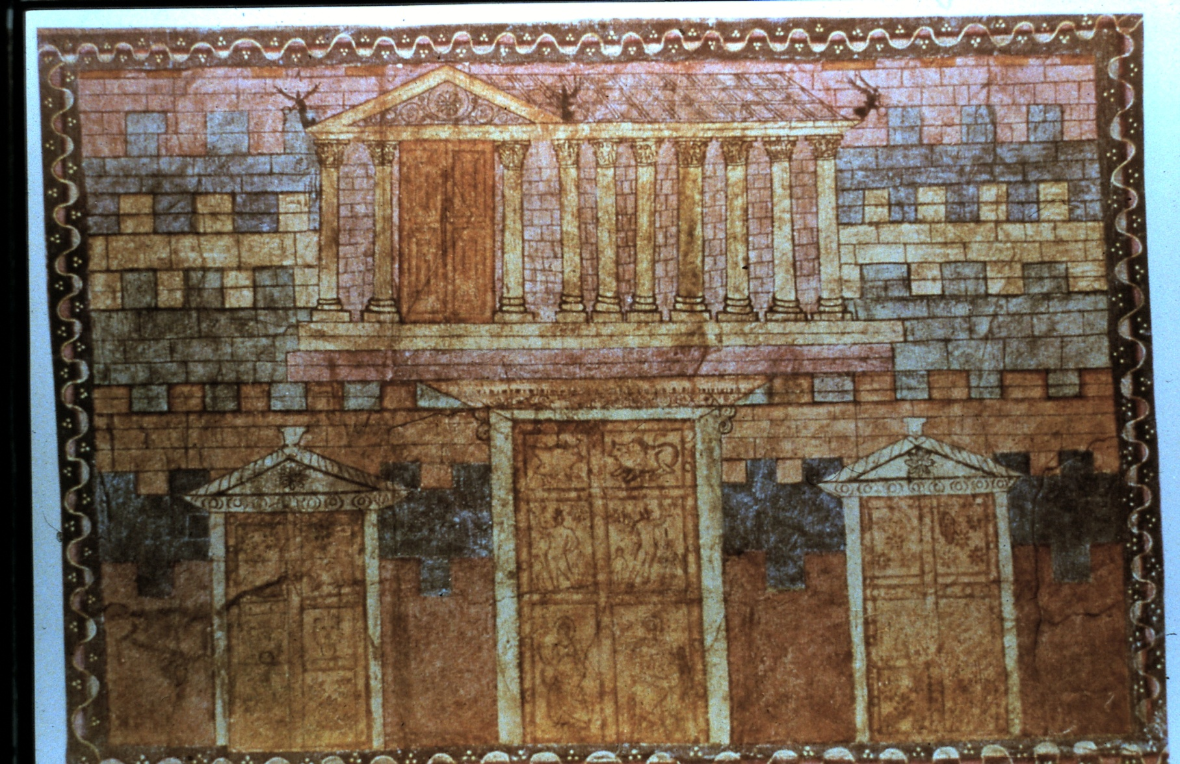
Hopes
Josephus, in Against Apion, written in the 90s AD, uses present tense to describe Temple
God requires sacrifice at temple (Deuteronomy); therefore if he temporarily makes that unavailable, it is because of sin
Temple will surely be rebuilt as original temple was after time of punishment and reflection

Slide 37
Frustrated hope?
Nerva, a senator becomes emperor on Domition’s assassination in 96
Unconnected with conquest of Judea, so he has no inherent anti-Jewish bias
Repeals Capitoline tax on Jews

Slide 38
Hopes Dashed
Trajan (98 AD)
His father a general of Xth legion under Vespasian
renews tax
No texts speak of Jewish reactions

Slide 39
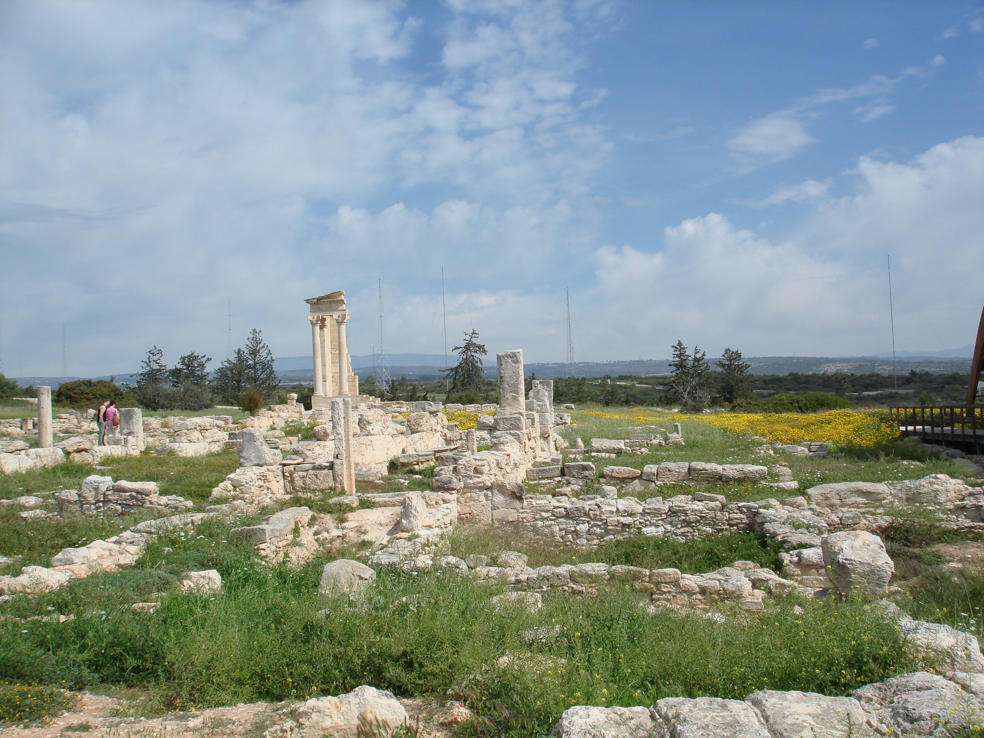
Speculation: Absolute despair?
Renewal of tax means no temple
God has not brought about his return; instead the enemies of God expand
Focused on former Ptolemaic empire
Temples targeted in Cyrene: Isis, Zeus, Demeter
Possibly temple of Apollo at Kourion.

Slide 40
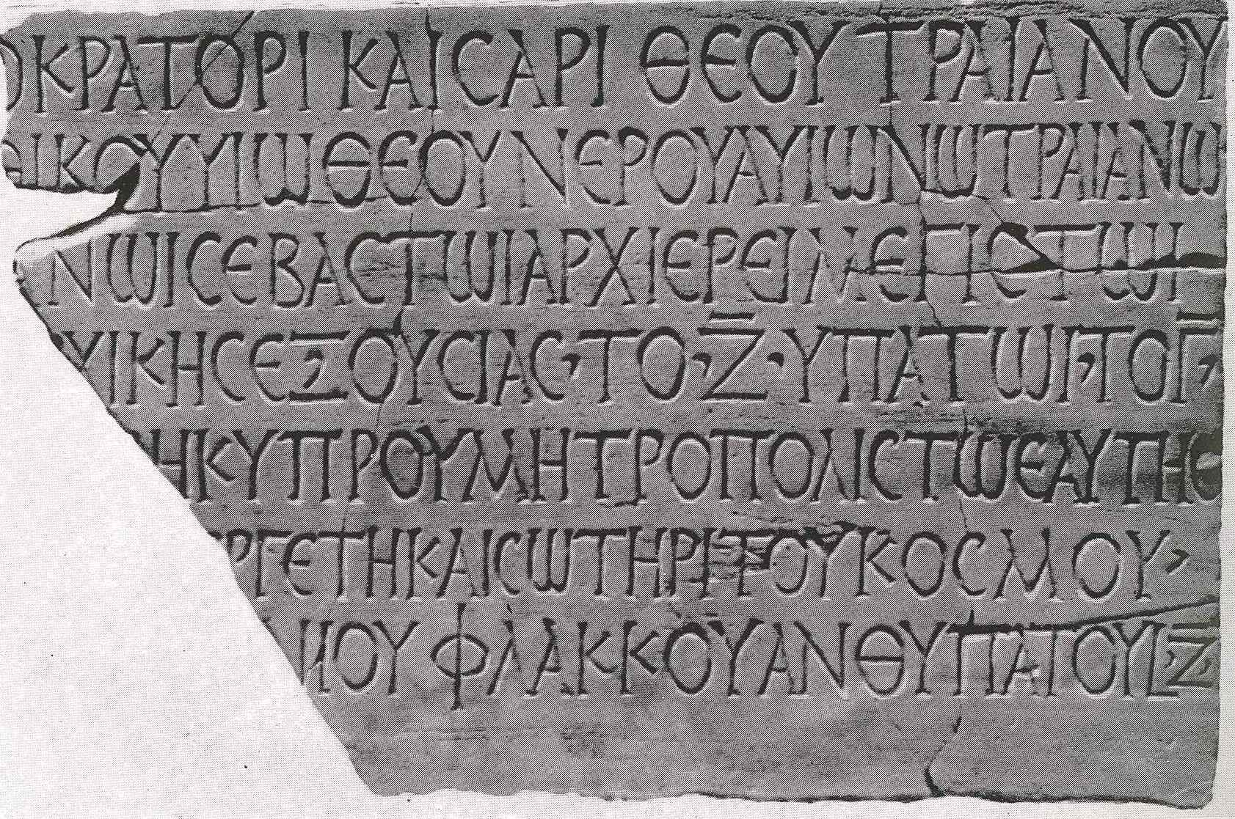
Savior of the world
Salamis honors Hadrian as the savior of the world for restoring Salamis after the revolt
Another inscription, Antonine in date, forbids an unknown ethnos to have an association

Slide 41
Thank You tdavis@swbts.edu

